Slide 1
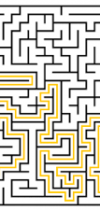
Maze Implementation, Analysis and Design to find Shortest Paths
Aadhi Suresh

Slide 2
Informal Problem Statement
To analyze the difference in time and path taken of three different algorithms
To do this we will implement 2 algorithms: DFS and BFS Algorithm
Notes:
A perfect maze is a maze without loops

Slide 3
What is a Maze?
A maze is a path or collection of paths, typically from an entrance to a goal through which the solver must find a route.

Slide 4
Solving A Maze
Maze solving is the act of finding a route or path through the maze from start to finish. Some maze solving methods are designed to be used inside the maze by a traveler with no prior knowledge of the maze, whereas others are designed to be used by a person or computer program that can see the whole maze at once.

Slide 5
Real Life Application
Navigation
Artificial Intelligence/Robotics,
Computer Games
Computer Simulations
Virtual Reality
Military
Notes:
Mazes are a simplified form of navigation. Developments used in efficient maze solving have helped other n

Slide 6
Maze Representation
Our maze was designed as positions on a graph and are identified by (x,y) coordinates. Our maze is a collection of these coordinates or cells in a 2-d array.
At any given moment, you can only step in one of 4 directions. Valid moves are:
• Go North: (x,y) -> (x,y-1)
• Go East: (x,y) -> (x+1,y)
• Go South: (x,y) -> (x,y+1)
• Go West: (x,y) -> (x-1,y)
Notes:
A node in the graph represents a possible map location.
In this discussion, we will imagine a node n as a single point with an (x, y) coordinate.

Slide 7
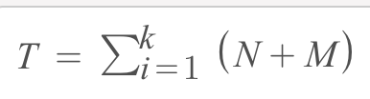
Formal Problem Statement
N = Number of Correct Nodes Visited
M = Number of Incorrect Nodes Visited
T = Total Nodes Visited
k = size of the vertex list
Notes:
Given a set of nodes, G, each representing a state
A set of Given coordinates representing a graph maze,, and two vertices s and t, solve for the k shortest paths from s to t in increasing order of length. After each run, two values were noted: the number of total path nodes in the final solution and the total run time.
An adjacency list is where vertices are stored as objects and every vertex stores a list of adjacent vertices.

Slide 8
Maze Constraint Requirements
The maze is perfect. Which means it has no loops and only one way to reach the exit.
The maze has to be able to accept different input parameters, to create mazes of various sizes.
The maze doesn't have to be braided. Meaning dead-ends are allowed.

Slide 9
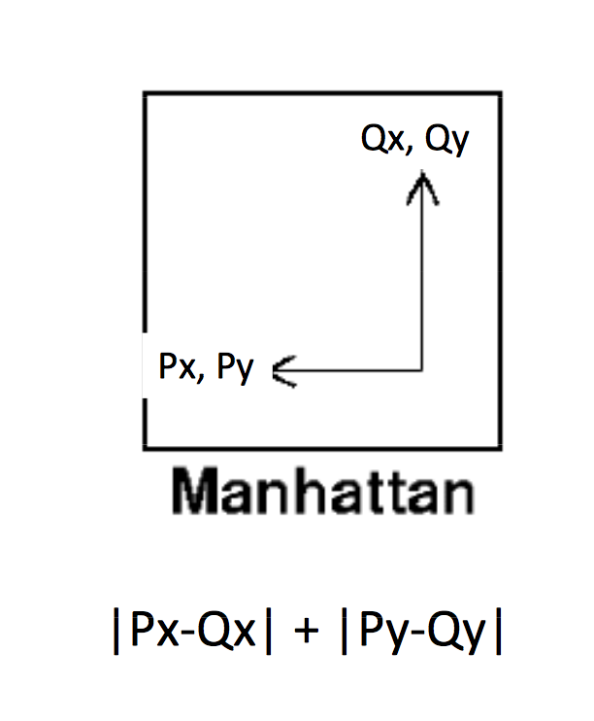
Heuristics: Manhattan Distance
H(current_node) = abs(currentX-goalX) + abs (currentY-goalY)
Heuristic Function calculating cost—>
f(n)=g(n)+h(n)
g(n) : represents the cost of the
path from the starting cell to the current cell.
h(n) represents the cost of moving from the current
node to the goal node.
Notes:
Manhattan distance from node to goal (ignoring obstacles)

Slide 10
Depth First Search
DFS is an example of a brute-force search algorithm.
DFS keeps walking down a path until it is forced to backtrack. It backtracks until it finds a new path to go down.
Time Complexity: O(|V|+|E|)
Notes:
Is brute force because all nodes are traversed until the goal node is found. Recursive
*last in first out

Slide 11
Depth First Search Steps
Visit the start node (or current node) and push onto a stack so we can remember it and then mark it so we won’t visit it again
Go to any node adjacent to the current node that has not been visited yet
Mark it as visited, and push it onto the stack
Continue visiting the next adjacent nodes, until you reach a node that has no other adjacent nodes.
Next pop off nodes from the stack until you find a node that has other unvisited nodes adjacent to it that you can evaluate.
Repeat steps 2 through 5 until end is reached.
Notes:
1.

Slide 12
Depth First Search Visualization

Slide 13
Breadth First Search
BFS is also an example of a brute-force search algorithm.
BFS, unlike DFS, explores all nodes nearest to root nodes before exploring nodes furthest away
Time Complexity: O(|V|+|E|)

Slide 14
Breadth First Search Steps
1. Begin at the starting node(current node).
2. Visit all unvisited nodes adjacent to the current node(if there is one) mark them as visited, and insert them into the queue.
3. After visiting all adjacent nodes, remove a node from the queue (if possible) and make it the current node.
4. Continue repeating steps 2 and 3 until goal is reached.
Notes:
Queue: first one in first one out

Slide 15
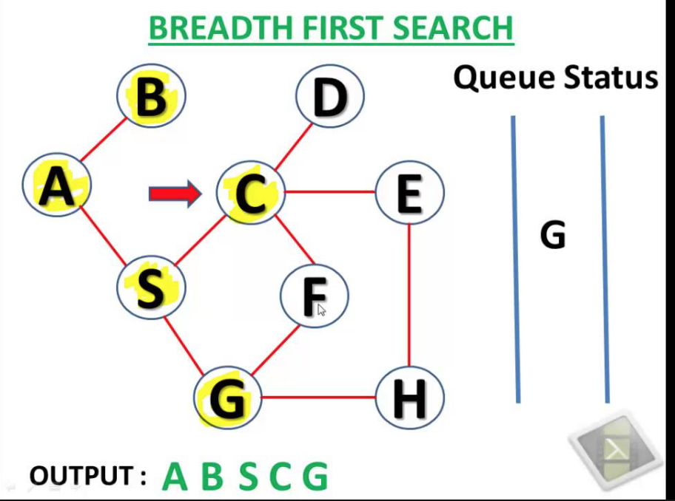
Breadth First Search
Notes:
First, it visits all locations one step away, then it visits all locations that are two steps away, and so on, until an exit is found.

Slide 16
How We Determined Most Efficient Algorithm
Total Number of Nodes Visited averaged for each m x n maze size:
DFS_AVG = [DFS(1), DFS2), DFS(3), DFS(4), DFS(5)] / 5
BFS_AVG = [BFS(1),BFS(2), BFS(3), BFS(4), BFS(5)] / 5
This same formulation was used to average the runtimes for each maze m x n size:
Total Number of Nodes Visited averaged for each m x n maze size:
DFS_TIME = [DFS(1), DFS2), DFS(3), DFS(4), DFS(5)] / 5
BFS_TIME = [BFS(1),BFS(2), BFS(3), BFS(4), BFS(5)] / 5
Notes:
You can use a hashtable to store the parent of each node, so you can get the path from root to target.

Slide 17
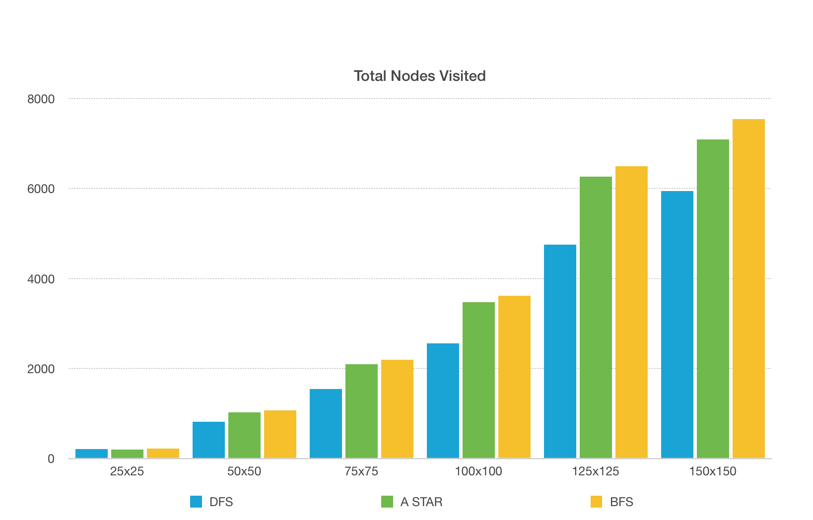
Results

Slide 18
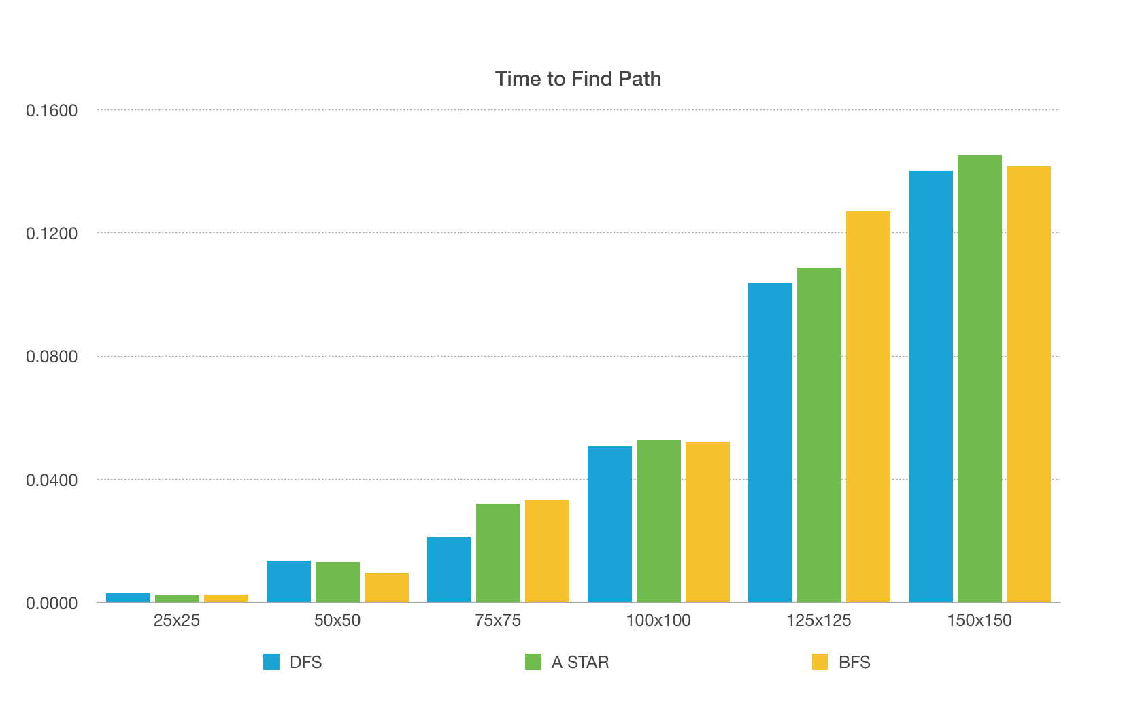
Results

Slide 19
Future Work
Assess other search algorithms. Like Dijkstra’s, Pledge Algorithm or Dead-end filling
Run algorithms against mazes with multiple solution paths
Notes:
Path Finding Solutions for

